Slide 1
Digital garden
MIRAHI Growth :
Ghost Discovery &theming

Slide 2
What is Ghost?
Non-profit foundation founded in 2013
Initially focused only on professional publishing for journalists and writers
Now installed more than 2,500,000 times, from single users to large corporations
Can be self-hosted or used as a service (GhostPro) with several tiers / prices
The service profits fund the development of the open-source application

Slide 3
The parts
Admin
JSON API
FRONTEND
Web interface
For admin config
Text editor for posting content
Connects to various DBs (SQLite3 in dev, MySQL in prod by default)
NQL query language allows filtering
Choose existing theme of build your own
Handlebars on top of HTML allows for data interpolation, iteration & conditions
Vanilla JS (or jQuery) for custom logic (eg. Dark mode switch)

Slide 4
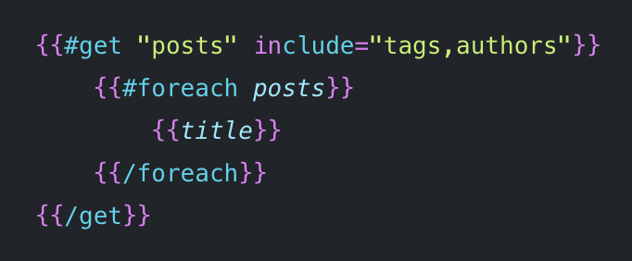
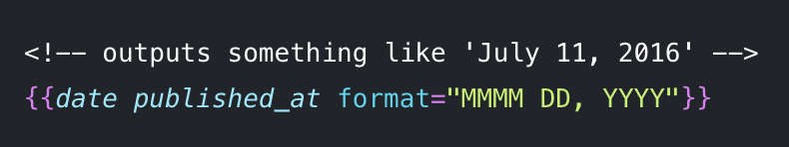
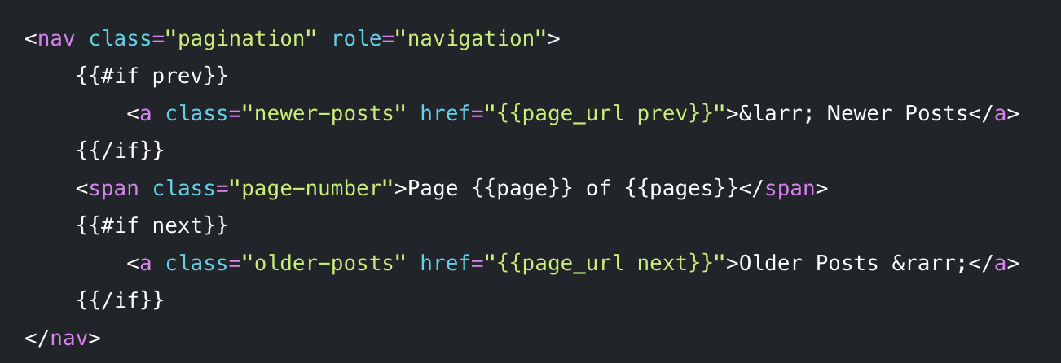
Handlebars
Templating language
Full set of helpers, from core Handlebars and Ghost-specific
Functional helpers: foreach, if, unless, get, …
Data helpers : @config, @site, post, img_url, date, …
Utility helpers : ghost_head, ghost_footer, reading_time, plural, translate, …

Slide 5
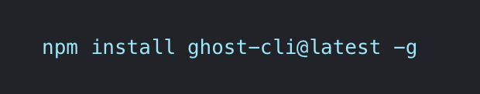
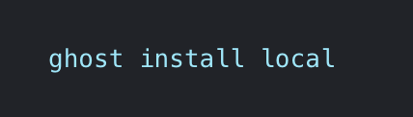
Installation & Ease of use
Easy to install
Readable documentation
Live reload in dev

Slide 6
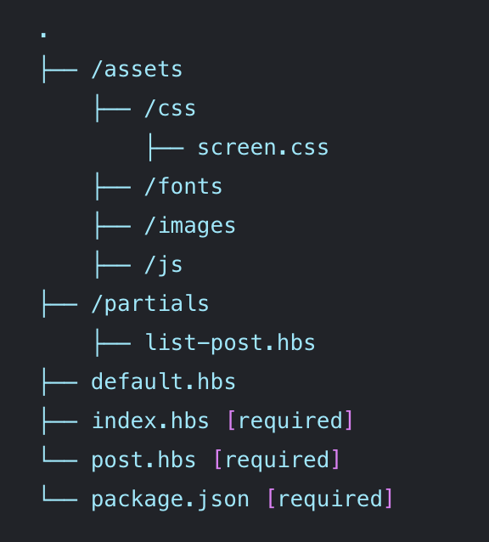
Structure
Some templates are required, while others have overwritable defaults
Partials allow reuse of small template block
Custom templates allow for different types of posts
Post templates have access to the same data but can display them differently

Slide 7
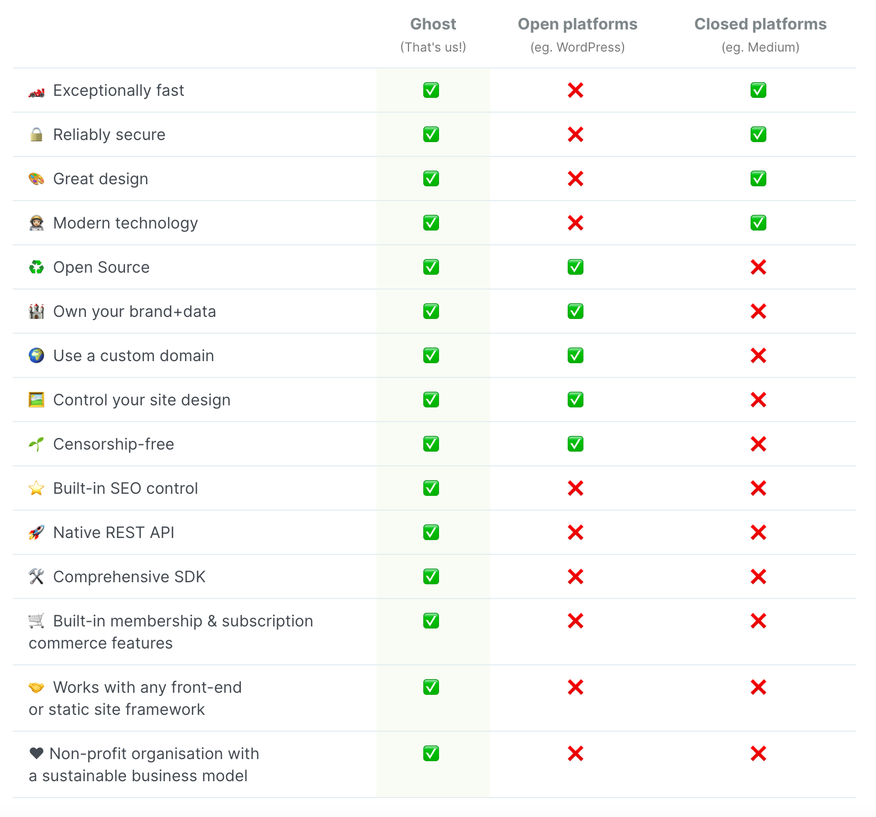
Comparison with similar platforms
The most important feature for content creators is probably the membership & subscription features : Ghost sells the platform as “Make your own Patreon”

Slide 8
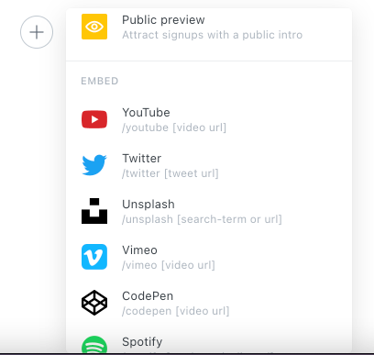

HOW DOES IT INTEGRATE…
IN Text editor?
AS HEADLESS CMS?

Slide 9
Nice-to-haves Exclusive to frontend
Automatic management of tags & authors in addition to posts: generates routes
Automatic sitemap for SEO
Automatic OpenGraph structured data
Automatic pagination

Slide 10
Questions?

